Slide 1
EWER COMMUNITY FORUM & COMMUNITY SAFETY PARTNERS

Slide 2
EARLY WARNING EARLY RESPONSE STRUCTURE
Technical Experts: PlanetScape AI, CSO, CLEEN, UCLA
4
States
Zamfara
Kaduna
Pla teau
Taraba
State
State
State
State
+ CLEEN State Coordinators
EWER Forum Members
Gusau LGA (2)
Bungudu LGA (2)
Kajuru LGA (2)
Chikun LGA (2)
Barkin Ladi LGA (2) Jos South LGA (2)
Wukari LGA Gassol LGA (2)
160
4 Local Communities
4 Local Communities
4 Local Communities
4 Local Communities
10 EWER Forum members per community =
40
EWER Forum members
10 EWER Forum members per community =
40
EWER Forum members
10 EWER Forum members per community =
40
EWER Forum members
10 EWER Forum members per community =
40
EWER Forum members
Consultants
Safety Partners
8Partners
8Partners
8Partners
8
32
Community
Community
Community
Community
Community
Safety Partners (2 per
community)
Safety
Safety
S ety
(2 per community)
(2 per community)
(2 per community)
50% CSP Gender balance

Slide 3
EWER Stakeholder Forum Members
EWER Stakeholders Forum will be a group of people that are drawn from the EWER host community. They should have a solid knowledge of the community, respected, be concerned about the safety of the community and willing to observe the terms of references.
Membership of EWER Stakeholders Forum should Be a cross section of Traditionalists, Youth Groups, Women, Religious Groups, Informal Security/vigilante groups and various Ethnic Groups

Slide 4
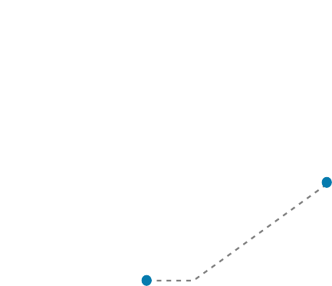
Reliability - commitment to community safety
01
EWER Forum Selection Criteria
Convening power/capacity to mobilize support
02
Past leadership/security
03
experience
Criteria for Group Selection of EWER Forum Members
04
Knowledge of the community’s
history/political issues
05
Integrity and no history of criminality

Slide 5
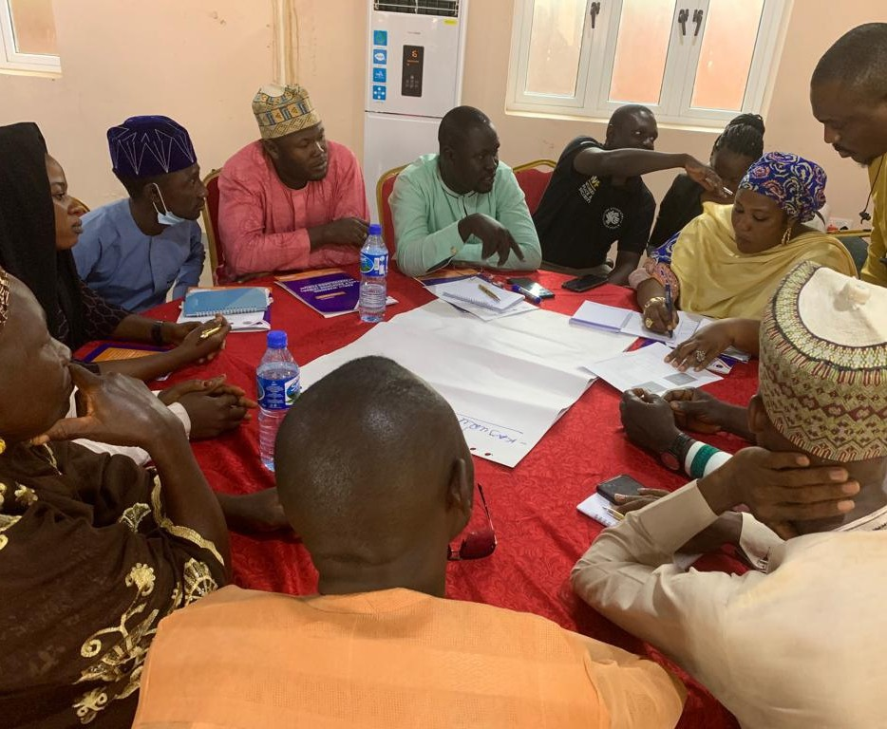
Community Safety Partners (CSPs)
Community Safety Partners are people who have an understanding of regional conﬂicts and are committed to the assessment of violence by mobilizing decision making and putting in place strategies to mitigate and contribute to the de-escalation of violence.
The CSPs will include people from civil society organizations, community leaders, state security and law enforcement bodies, and informal security groups that have legitimacy in communities they serve.

Slide 6
01
Reliability – commitment to community safety
02
Convening power/capacity to mobilize support – will others listen to them
Past experience -
track record with security for community
Criteria for Group Selection of Community Safety Partners
03
04
Knowledge of the community’s history/political issues
05
Integrity , Respect and no history of criminality
Criteria for Group Selection of Community Safety Partners
06
Ability to use mobile phone
07
Commitment to documentation of violence and abductions
08
Commitment to Collaborative work

Slide 7
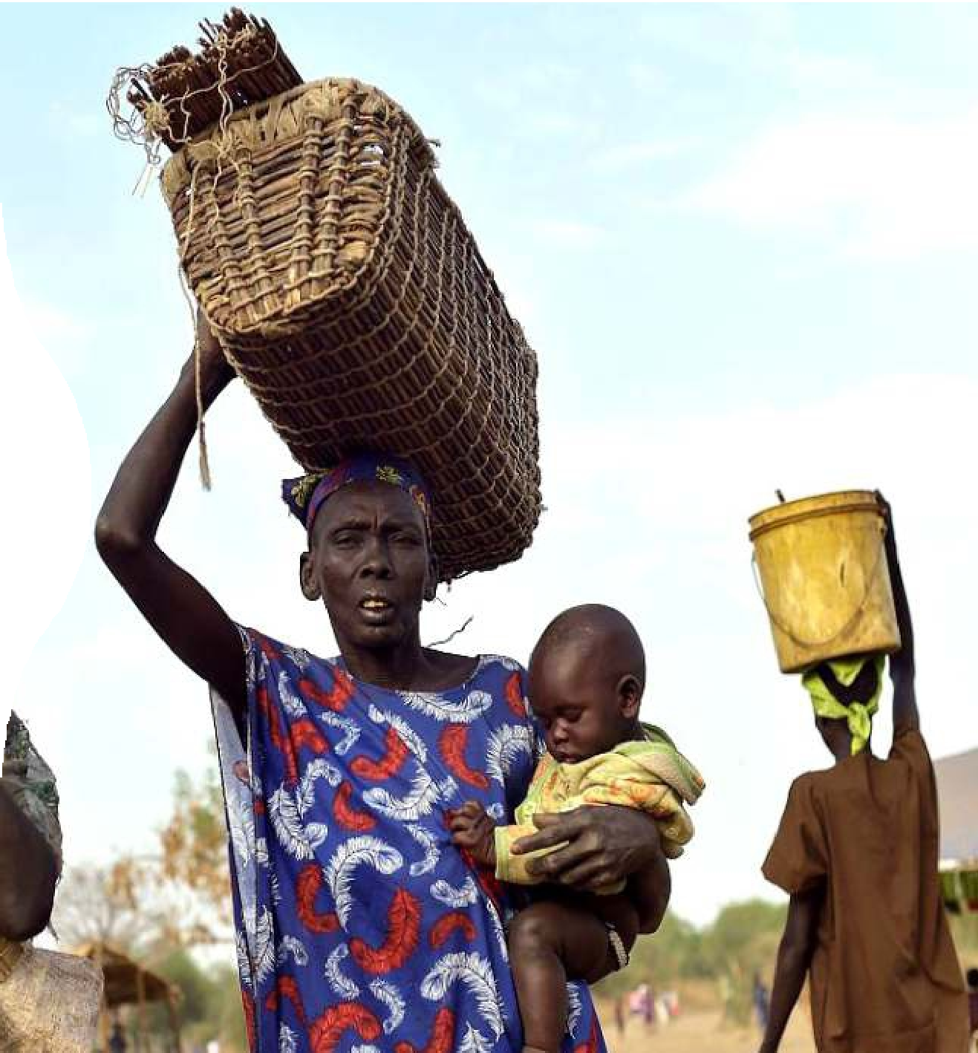
Gender Commitments
Women are disproportionately aﬀected by violence and therefore must participate in the strategic solutions.

Slide 8
Training and Planning Phase
Community, Institutional & Security Mapping
Translated nomenclature, selection criteria
Constitution of EWER Forum/Selection of CSPs
Government/Traditional/ ReligiousLeader Buy-ins
Communication channels created for EWER/CSPs
Periodic meetings/Security Review by EWER Forum
EWER Forum members trained on technology, Standard Operating Procedures &Risk Mitigation
Initial Attack
PlanetScape Ai
Warning Phase
Identify Stakeholders
Share info
Share info
HOW THE PROJECT WILL WORK
EWER
Stakeholders
Consult EWER Plans
Community Safety Partners
Verify attack
CLEENApp Imagery/ Videos
Risk Assessment Phase
Assessment of violence
Local Community Intelligence
Range of Immediate Responses
Refer to Religious/Traditional Organizations
Send alert via CLEEN App/WhatsApp Groups
Response Phase
Alert security agencies Consult Community Leadership
Alert those at Risk with Radio communications Engage with IDPs
Evacuate Communities
Operationalise Security Protection
Middle to Longer Term Response
Local Government Referrals Trigger State Peace Building Strategy
De-escalation Phase
De-escalation/ Prevention of cycles of violence
Trigger Social/Community Welfare Development Oﬃce
Trigger Longer term Land Resolutions
Trigger Repatriation of Homes
Enhance the legitimacy of the CSPs and EWER Forum Members

Slide 9
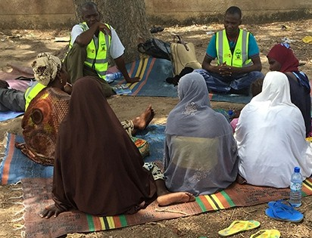
TRAINING AND PLANNING PHASE
Community, Institutional & Security Mapping
Translated nomenclature, selection criteria
Constitution of EWER Forum/ Selection of CSPs
Government/ Traditional/ Religious Leader
Buy-ins
Communication channels created for EWER/CSPs
Periodic meetings/ Security Review by EWER Forum
EWER Forum members trained on technology, Standard Operating Procedures &
Risk Mitigation

Slide 10
WARNING PHASE
Initial Attack
PlanetScape Ai
Identify Stakeholders
Share info
Share info
EWER
Stakeholders
Consult EWER Plans
Community Safety Partners
Verify attack
CLEENApp Imagery/ Videos
Assessment of violence
Local Community Intelligence

Slide 11
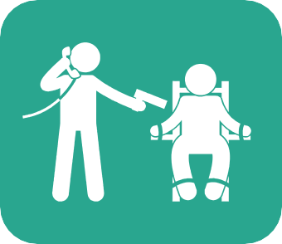
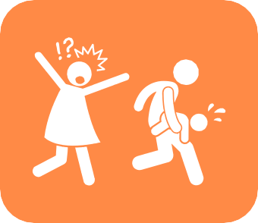
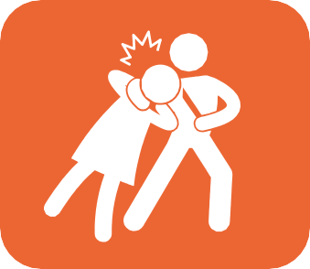
RISK ASSESSMENT
Herder-Farmer/Indigene Violence sometimes leading to land dispossession of Indigenes and settlers; often plays out along ethnic and religious diﬀerences; reprisal killings; burnings
Communal Clashes playing out along ethnic and religious lines.
Banditry
economic dispossession. Started with cattle rustling, raiding and stealing; moved to taxation oriented with levies; burnings
Political Violence against State and Hegemonic Institutions “Terrorism” – suicide bombings, abductions, Boko Haram mobilizations, also state capture violence/across Nigerian borders.
Abductions/Kidnapping and Ransom payments
(often because raiding may not produce enough economic gains)
Abductions/Kidnapping/ Ritual Killings for body parts

Slide 12
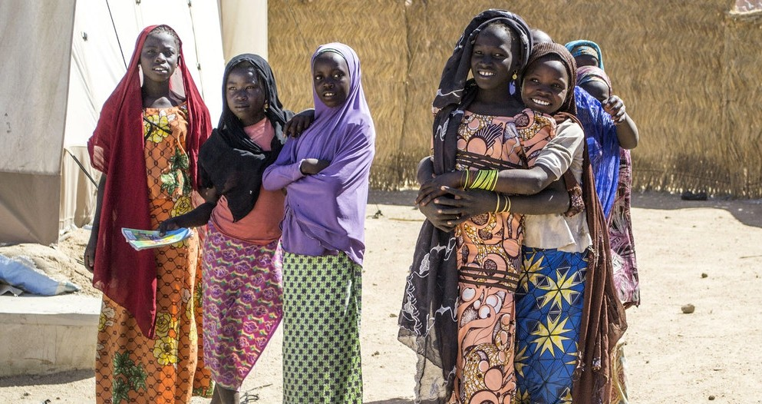
RESPONSE PHASE
Refer to Religious/ Traditional Organizations
Send alert via CLEEN App/ WhatsApp Groups
Alert security agencies
Evacuate Communities
Consult Community Leadership
Engage with IDPs
Alert those at Risk with Radio communications
Operationalise Security Protection

Slide 13
RESPONSE PHASE
Refer to Religious/ Traditional Organizations
Send alert via CLEEN App/ WhatsApp Groups
Alert security agencies
Evacuate Communities
Consult Community Leadership
Engage with IDPs
Alert those at Risk with Radio communications
Operationalise Security Protection

Slide 14
DE-ESCALATION PHASE
Middle to Longer Term Directions
Local Government Referrals
Trigger Longer term Land Resolutions
Trigger State Peace Building Strategy
Trigger Repatriation of Homes
Enhance the legitimacy of the CSPs and EWER Forum Members
Trigger Social/Community Welfare Development Oﬃce
Build Capacity and Expand Medical Facilities

Slide 15
EWER Forum | Community Safety Partners
Periodically discuss emerging security issues and risks in the community | Periodically discuss emerging security issues and risks in the community
Select the members of the community safety partners | Gather security information and share within the group and the CLEEN app.
Gather security information and share within the group and the CLEEN app. | Receive security alerts
Provide institutional, political and physical support to members of the CSPs | Analyse security alerts and warnings and decide on actions to mitigate attack
Conduct performance review for the CSPs | Share experiences and lessons with other CSPs in other communities
Advise the CSPs on the best course of action depending on the nature of violence | Hold a monthly meeting and attend the bi-monthly meetings with EWER Forum members
Hold a bi-monthly meeting with CSPs
Disseminate information about the Forum to the entire community
Terms of Reference for EWER Forum & CSPs

Slide 16
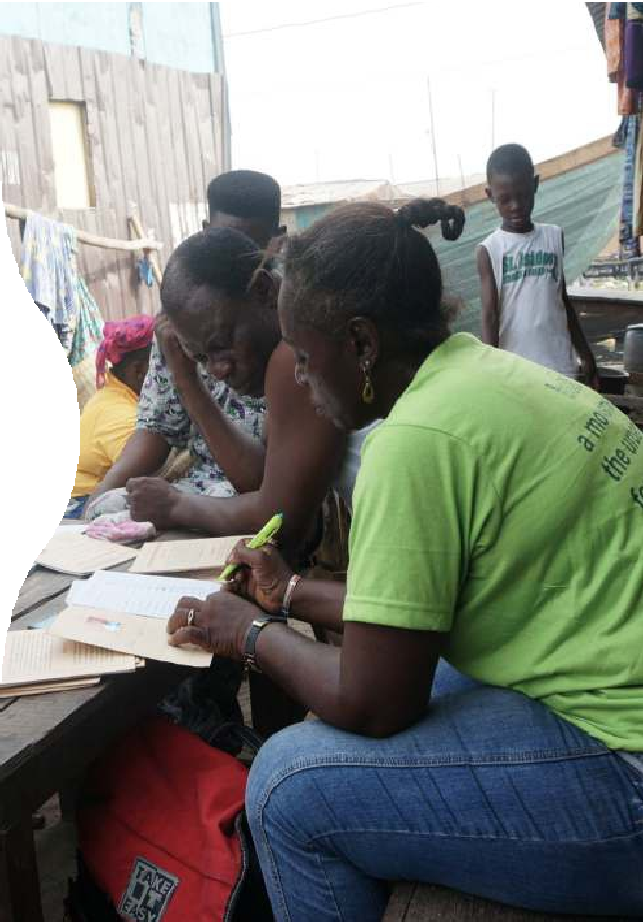
Consensus Decision Making
Consensus is a creative and dynamic way of reaching an agreement between all members of a group. Instead of simply voting for an item and having the majority of the group getting their way, consensus decision making involves a commitment to ﬁnding solutions that everyone actively supports, or at least can live with.

